Slide 1
Preventing extremism & violent radicalisation through restorative justice: An evidence-based model
Prof. Theo Gavrielides, Ph.D
Founder & Director
Restorative Justice for All International Institute
4/6/24

Slide 2
RJ4All International Institute - introductions
RJ4All Europe in Cyprus and RJ4All UK
Restorative Justice for All is a charitable international institute with a mission to address power abuse, criminality, conflict, and poverty through the use of restorative justice values and practices. We do this through a combination of restorative justice projects delivered both internationally, nationally and locally.
We advance community cohesion, equality, human rights, we offer early interventions and rehabilitation/restoration opportunities and we redistribute power by delivering social justice and poverty relief projects, educational programmes and high-quality volunteering opportunities for marginalised groups.

Slide 3
Restorative Justice for us
An ethos which guides our relationships, practices, and encounters:
"Restorative Justice is an ethos with practical goals, among which is to repair harm by including affected parties in a (direct or indirect) encounter and a process of understanding through voluntary and honest dialogue. Restorative justice adopts a fresh approach to conflicts and their control, retaining at the same time certain rehabilitative goals" Theo Gavrielides (RJ4All Founder and Director)
A diversionary option within the criminal and youth justice systems (all stages)

Slide 4
How does Restorative Justice fit in PVE?
The study of terrorism and extremism is first and foremost a study in human behaviour.
Restorative Justice is by default a user-led and participatory model
Core principles are: decision-making and power-sharing
It aligns with a systemic approach: it requires a deep understanding of the social environment, radicalisation processes, families and social field
It requires building trust and working alliances
Provides an opportunity for families and communities to be there for a holistic mechanism in place

Slide 5
Our response to violent radicalisation
Harm is the result of a combination of factors most of which are societal failures.
Traditional approach (Risk Need Responsivity Model) - focusing on the negative traits that lead adults and young people to harm and antisocial behaviour. (Andrews, Bonta and Hope, 1990)
However, concentrating on criminogenic needs is not a sufficient condition when it comes to building psychosocial resilience against the factors that lead to violence and harm including extremism.
Our approach (The RJiNEAR Model) - works towards a positive, growth-oriented change in life where a person at risk of radicalisation works on the development of the values, skills and resources towards life based on human goods.

Slide 6
The RJiNEAR Model
RJiNEAR model means "Restorative Justice through: I, myself, New Knowledge about myself, Emotional intelligence, Awareness of values, of options, of choice and Responding with growth ‘in spite of …’
https://www.rj4all.eu/rjinear-2/
Empirically validated psychological intervention - a model of resilience, crime prevention and control.

Slide 7
The RJiNEAR Model
Our model understands resilience as a capacity that can be expanded.
Its overreaching Theory of Change is transformation through participation.
Shift of focus:
Instead of “managing” people as “risks”, the model focuses on promoting talents and strengths and through this approach help develop positive identities.
The model also draws on community power and community involvement in proving a holistic approach to preventing extremist ideologies and indeed violent actions motivated by hate and extremism.
The model forms part of RJ4All's wider programme "Preventing & Addressing Violent Radicalisation and Extremism".

Slide 8
RJiNEAR Model
Basic principle: It works on a voluntary basis to support accountability and acknowledgement of the harm before moving on
It fosters, promotes and works on normal psychological variables and factors (perception, reasoning, emotional states, psycho-social processes, responses) that play a vital role within the complex array of components in progressing towards adopting extremist beliefs and radicalisation of ideology.

Slide 9
The RJiNEAR Model - Domains for change
Positive identity: self-concept; self-relatedness; self-presentation; self-worth; self-efficacy.
Emotional intelligence & relational competence: emotional regulation; relating to others; empathy.
Ideological flexibility & social liaison: perception of choice, options and alternatives; citizenship and diversity; community.
Responding with resilience
Existential ethics and uncertainty: tolerance; self-soothing skills; malleability
Growth and well-being: linking values, emotions and behaviours; internal congruence (self-governing vs. compliance to pressures).
5. Restorative justice ethos: power-sharing; identifying, forging and restoring social liaison; pain and reconstruction.

Slide 10
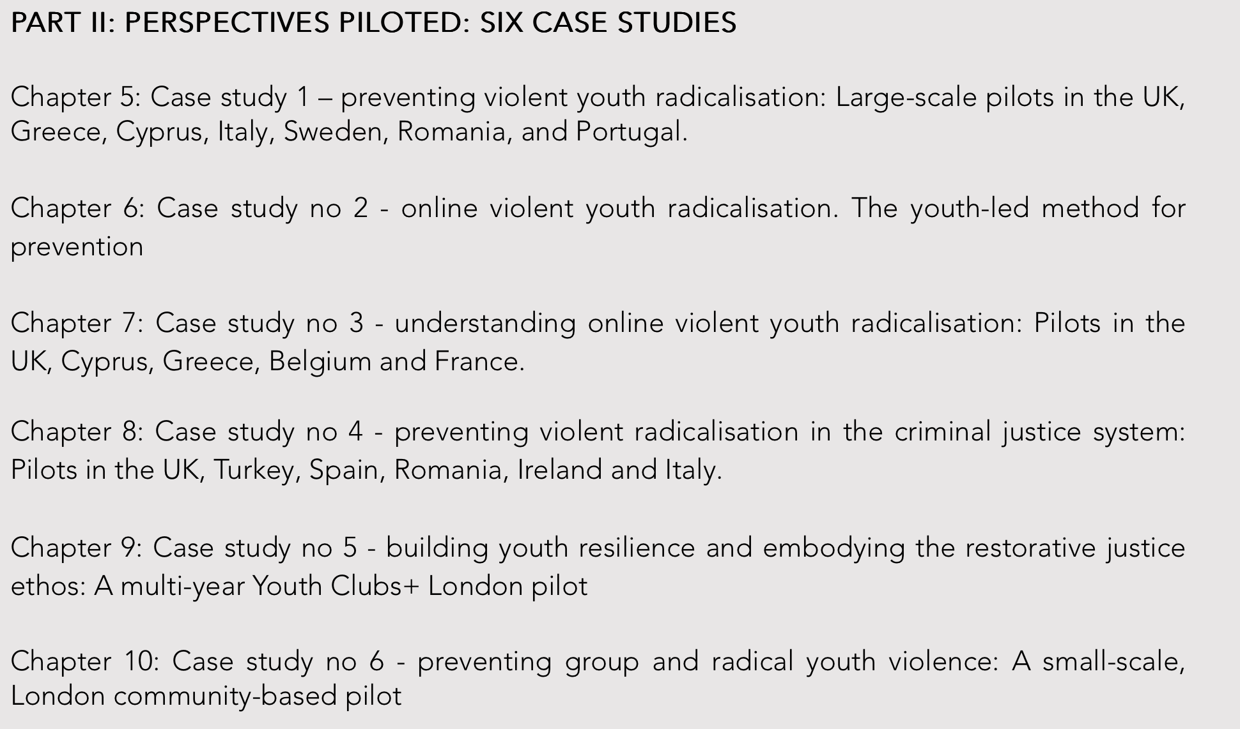
Case studies – pilots
https://www.theogavrielides.com/rjterrrorism

Slide 11
Limits
Barriers in the necessary multi-agency cooperation especially in CSO
Access to the target group
a. self-referrals
b. Case diversion from police or probation
c. Signposting from Youth Justice Services
3. Limited resources
4. Power dynamics
5. Expertise and training

Slide 12
Bibliography
Andrews, D. A., Bonta, J., & Hoge, R. D. (1990). Classification for effective rehabilitation: Rediscovering psychology. Criminal justice and Behavior, 17(1), 19-52. ​
Gavrielides, T. (2020a). New Directions in Preventing Violent Youth Radicalisation: Comparative and Summary Findings from the Youth Empowerment and Innovation Project (YEIP). IARS Publications.
Gavrielides, T. (2020b). “Violent Youth Radicalisation in Europe: The youth-led model”, Internet Journal of Restorative Justice, ISBN: 978-1-911634-22-5.
Gavrielides, T. (2018). Youth radicalisation, restorative justice and the Good Lives Model: Comparative Findings from seven countries, London: IARS Publications, ISBN: 978-1-907641-48-0.
Tunariu, A. D., Tribe, R., Frings, D., & Albery I. P. (2017). The iNEAR programme: an existential positive psychology intervention for resilience and emotional wellbeing, International Review of Psychiatry. International Review of Psychiatry, 29(4), 362-372.

Slide 13
RJiNEAR CPD e-course
https://rj4allecourses.com/courses/rjinear/

Slide 14
Experience restorative justice first-hand in the next session with a restorative justice circle!

Slide 15
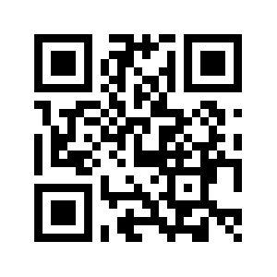
Questions & Answers
More information about our work: ​ ​
​ ​​
​ ​
RJ4All Europe, Rigainis 4, 1st Floor, Nicosia 1010, Cyprus.
admin@rj4all.org
@Rjforall
Tel: +35799363732
​
​ ​​
https://www.rj4all.eu

